Slide 1
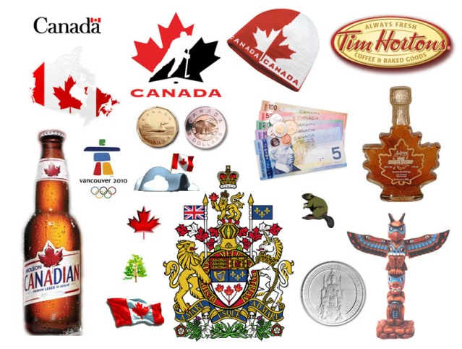
Woah, Canada!
A North American Country

Slide 2
Targets

Slide 3
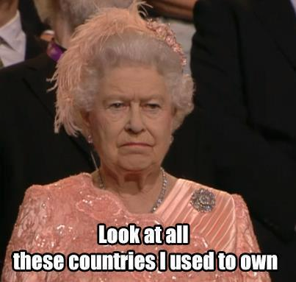
Historiography
Seymour Martin Lipset (1989) – small but significant differences in law and loyalty to UK. CAN tries to separate identity
James Bryce (1921) – CAN more traditional due to monarchy roots; national character different
W.L. Morton (1961) – CAN didn’t have revolution→ allegiance achieved independence
Arthur Schlesinger – multi-culturalism prevents development of national identity

Slide 4
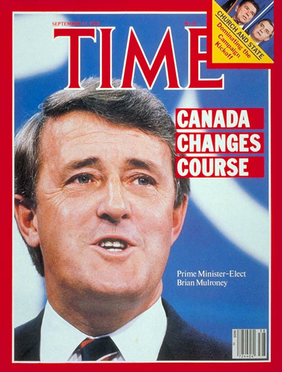
Louis Harty – “Founding Fragments Theory” – Both come from EUR history, but British CAN has “Tory touch”→ more conservative.
Harold Innis/Donald Creighton – Laurentian Thesis – CAN stretched Westward from St. Lawrence→ developed own “economic nationalism”
J.M.S. Careless – “limited identities” of provincialism and multiculturalism→ no national identity
PM Brian Mulroney (1992) – CAN becoming more and more American

Slide 5



Values Differences
Gov’t – Confederation w/ more provincial authority
Religion – Anglican (British) or Catholic (French) w/ church and state often blurred
Economics – States are a partner to federal gov; Public enterprise system→ planned economy

Slide 6

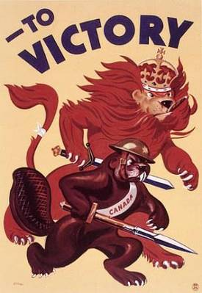
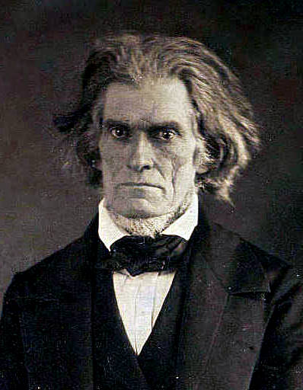
Law – 1867’s “Peace, Order, & Good Government” → stressed ordered society and collective resp.
Canada Act – Protects minority rights & provinces can “opt out” of constitutional provisions
Low crime rates; Stiffer gun control
Deep respect for law→ less likely to protest
If only
SC was in
Canada!

Slide 7


Elitism – More structured class system; education
Immigration – Mosaic vs. Melting Pot
less pressure for immigrants to assimilate
Multi-Culturalism as law (1971)
Bibby – “unassembled mosaic” rights valued over collective good→ coexistence is national goal
Provincial Autonomy? – Grown since 1867. Changed since founder’s intent (strong provinces)

Slide 8

Social Programs – Socialist welfare state
Paid out of tax revenue
Social security, welfare, healthcare provided with more extensive coverage
Of course, high taxes. Fits w/CAN social mentality
Development – About 2-4 decades behind US

Slide 9
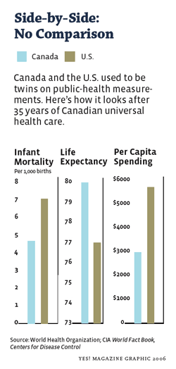
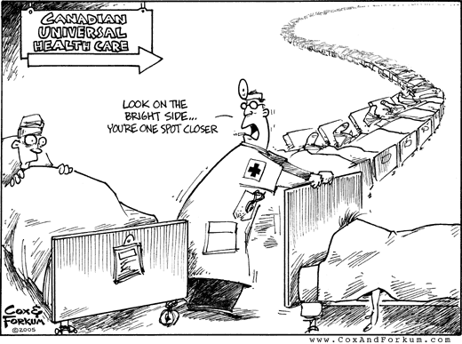
Canadian Healthcare
a

Slide 10

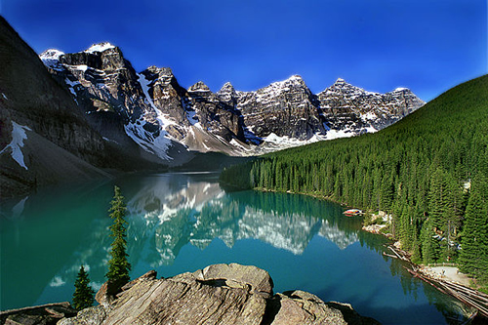
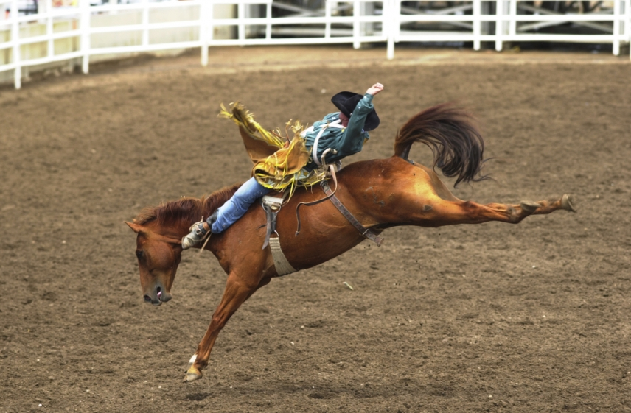
Similarities
Shared British legacy
Frontier settlements
Comparable immigrants
Same continent (flora/fauna/terrain/etc.)

